Slide 1

Programming for graphics
Normal Mapping

Slide 2
In previous Lectures we have seen:
Textures
How to send them to the GPU
How to apply them
Lighting
How to light a mesh
How to calculate the normal of a surface
How to add specularity

Slide 3
Normal Mapping
A combination of these techniques

Slide 4
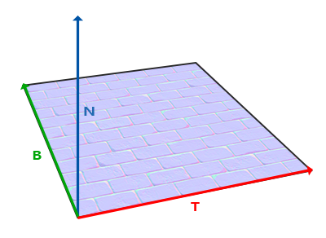
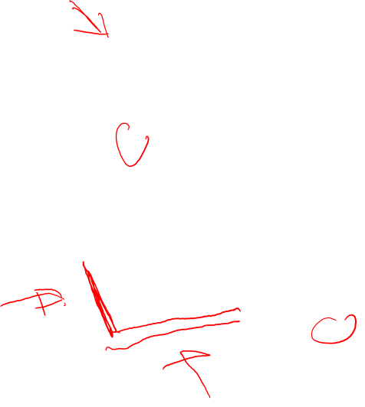
What is a normal
Normals are axis that are perpendicular to the surface of a plane

Slide 5
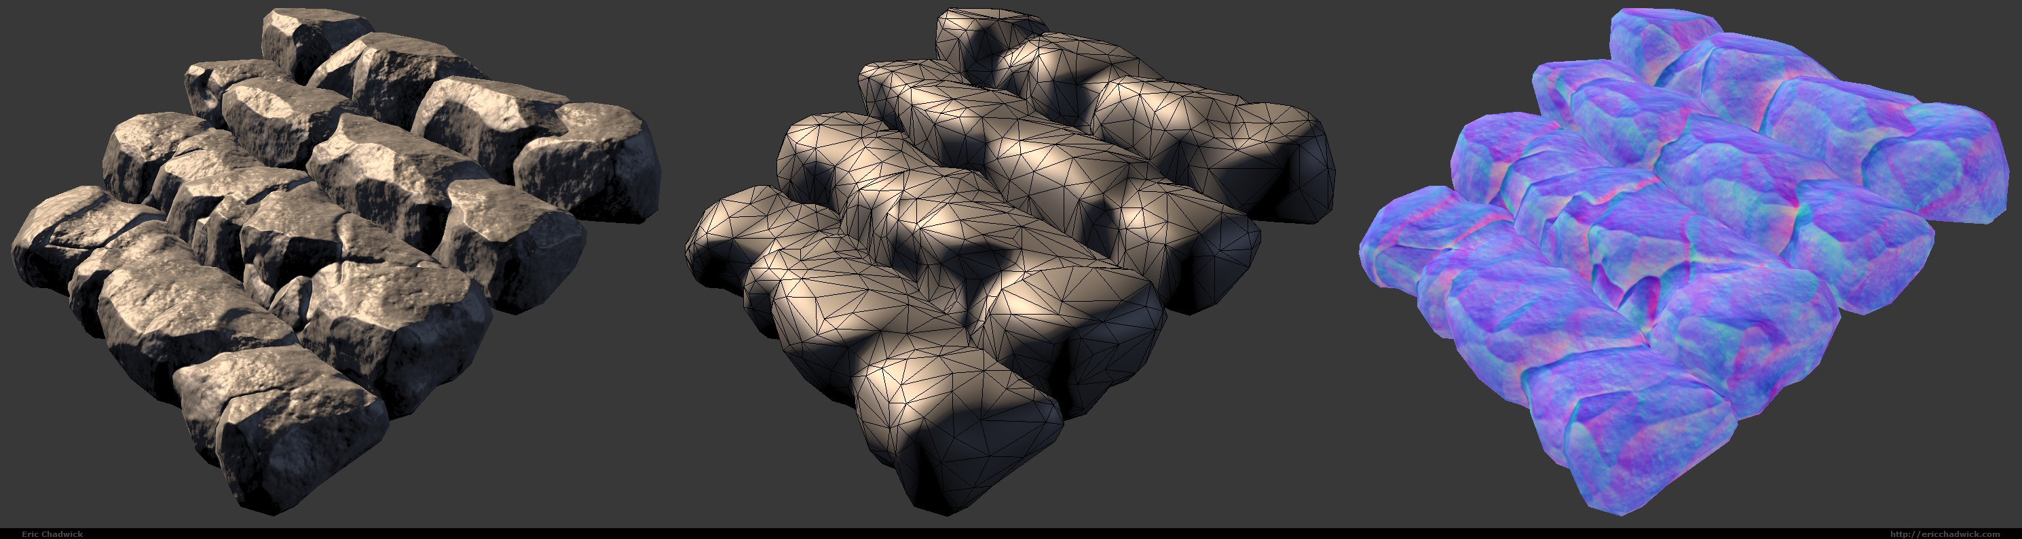
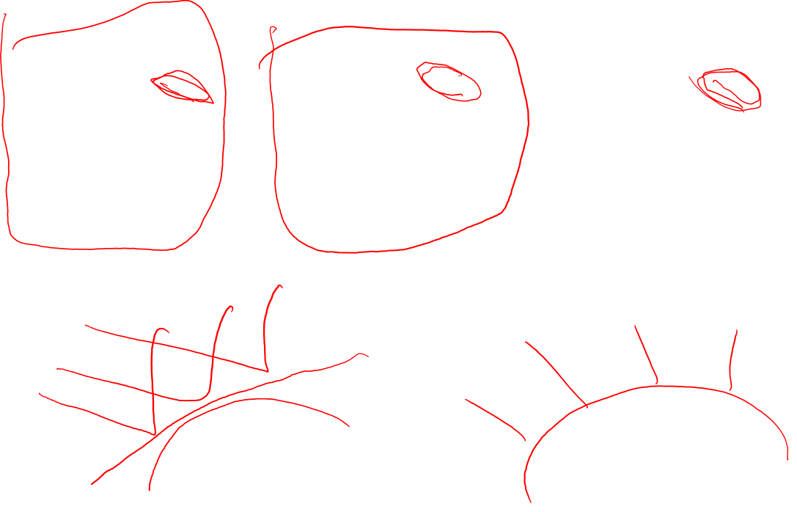
What is normal mapping
Normal mapping is where a texture (the purple blue thing on the right) is used to describe to the BRDF how the diffuse and specular lighting should be altered, per fragment, to give the illusion of more details in a surface.

Slide 6
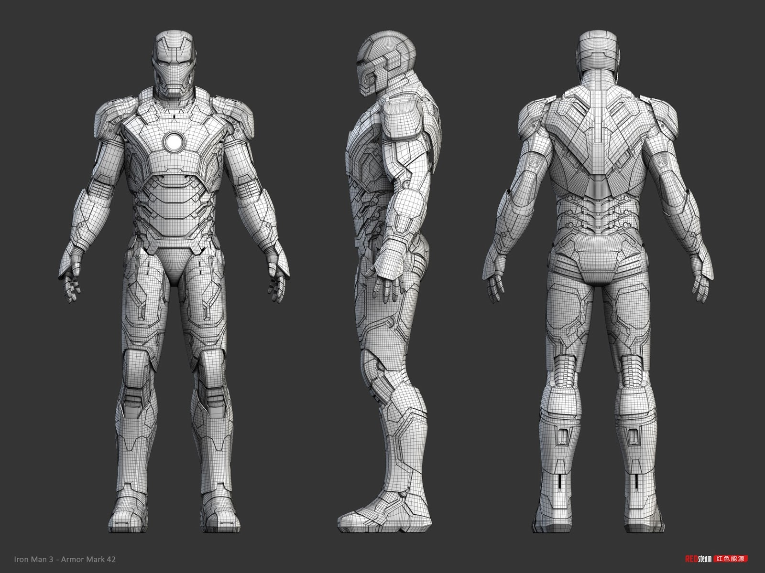
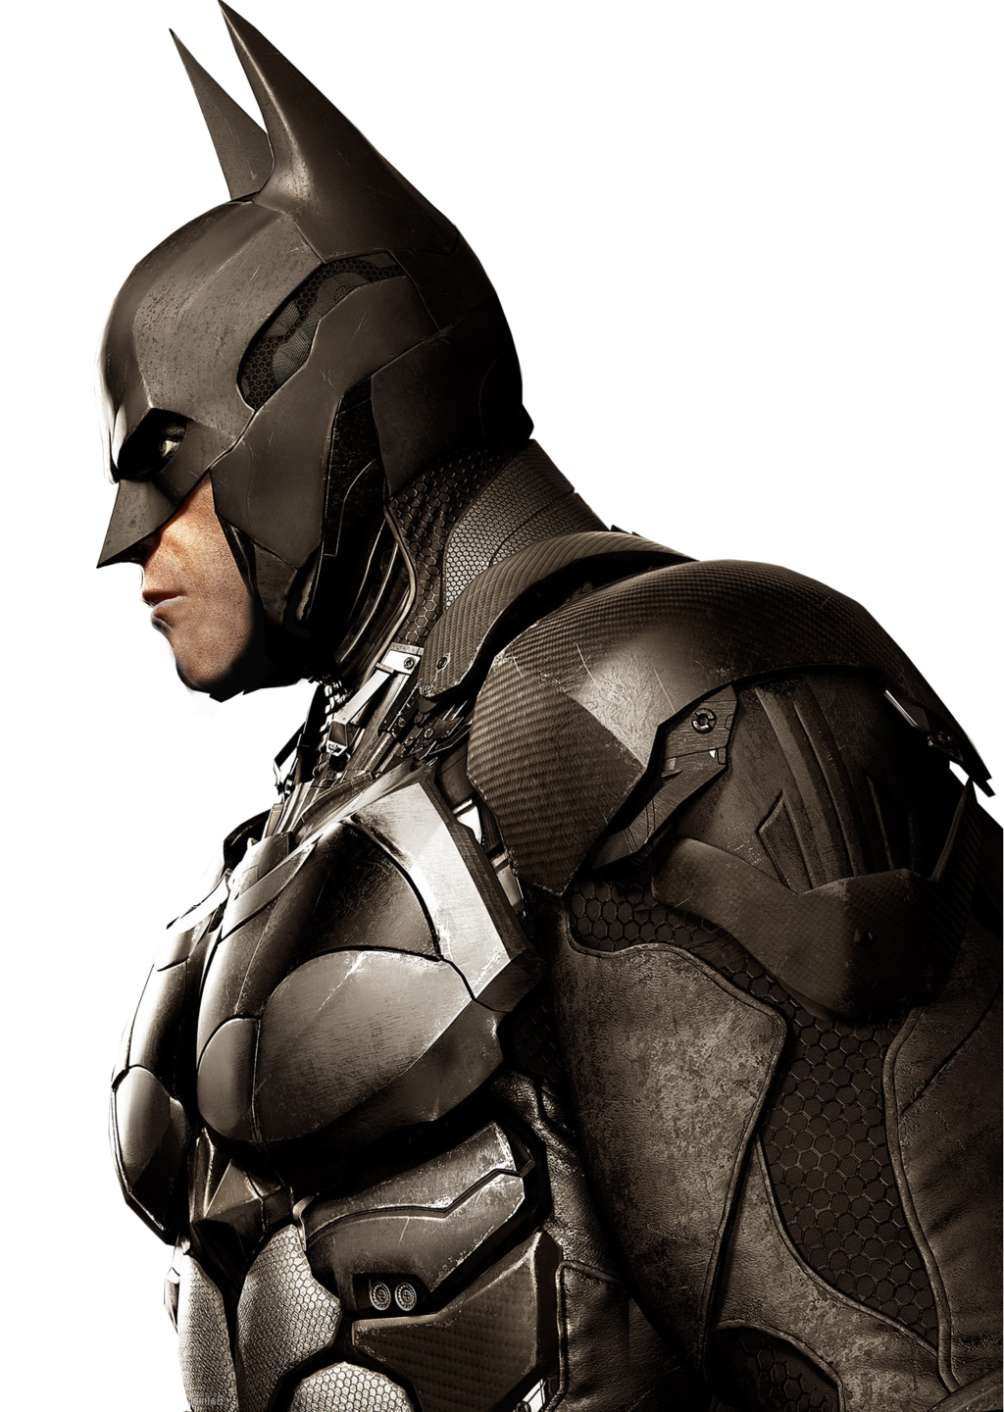
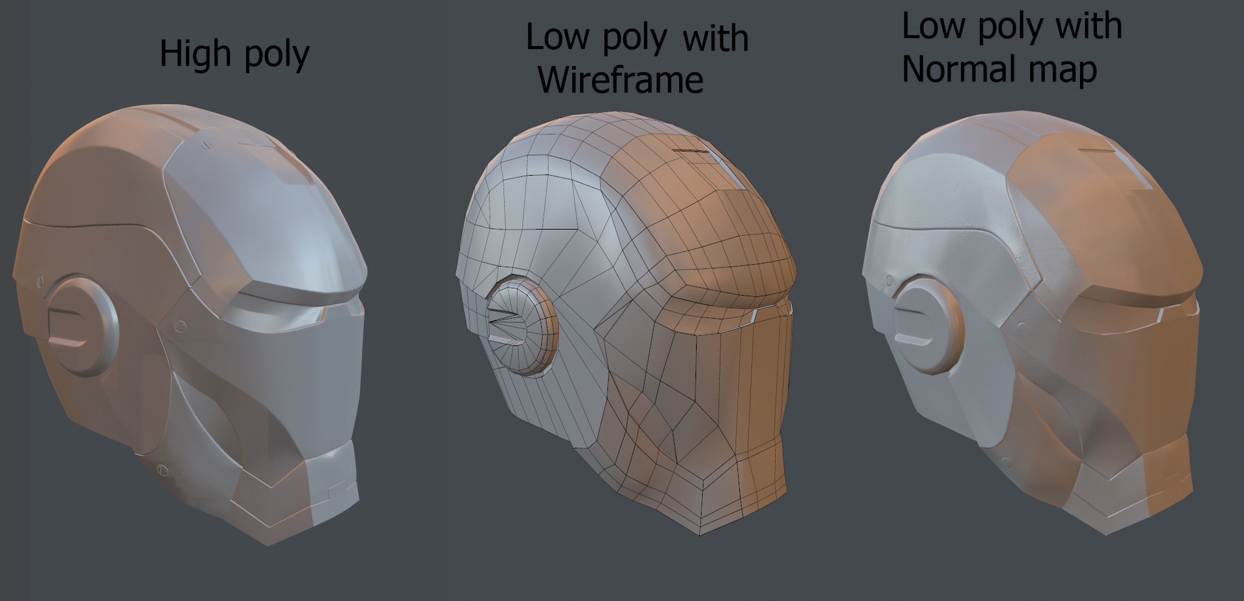
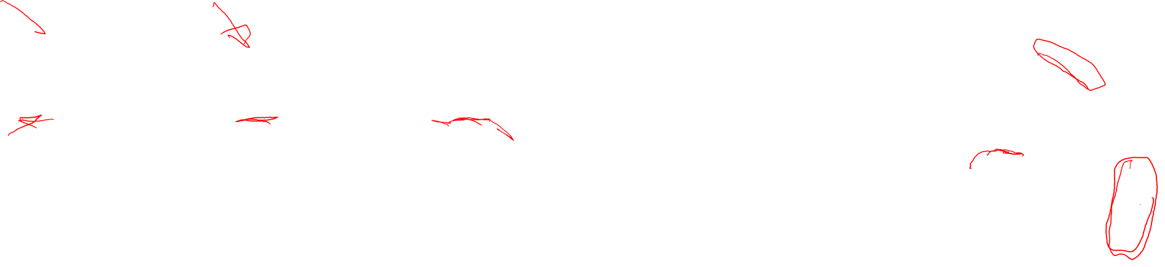
Why don’t we just use meshes with more detail

Slide 7
How does normal mapping work

Slide 8
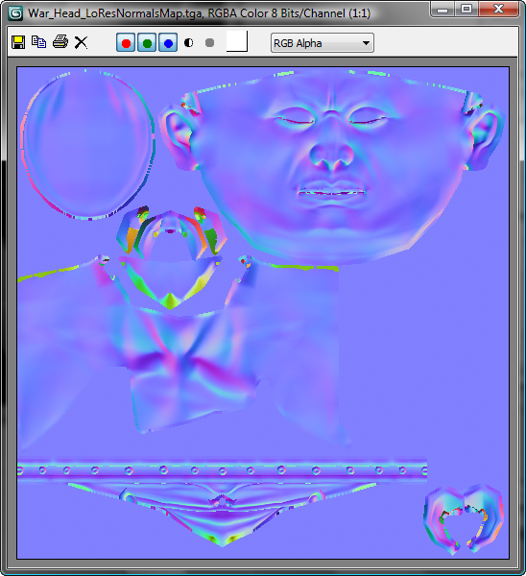
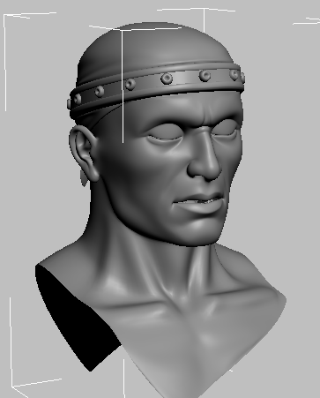
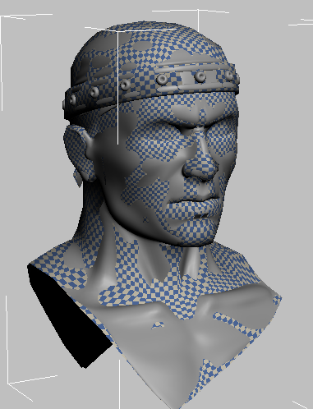
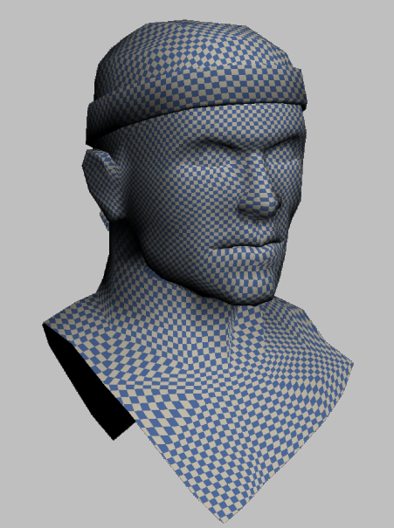
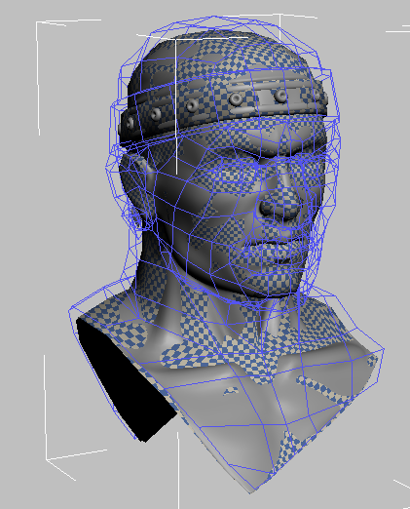
Generating Normal maps
Artists make a high detailed model.
Any a low detail model
Then use a technique called “projection mapping” to project the height detail on to the low detail and then render that to texture.

Slide 9
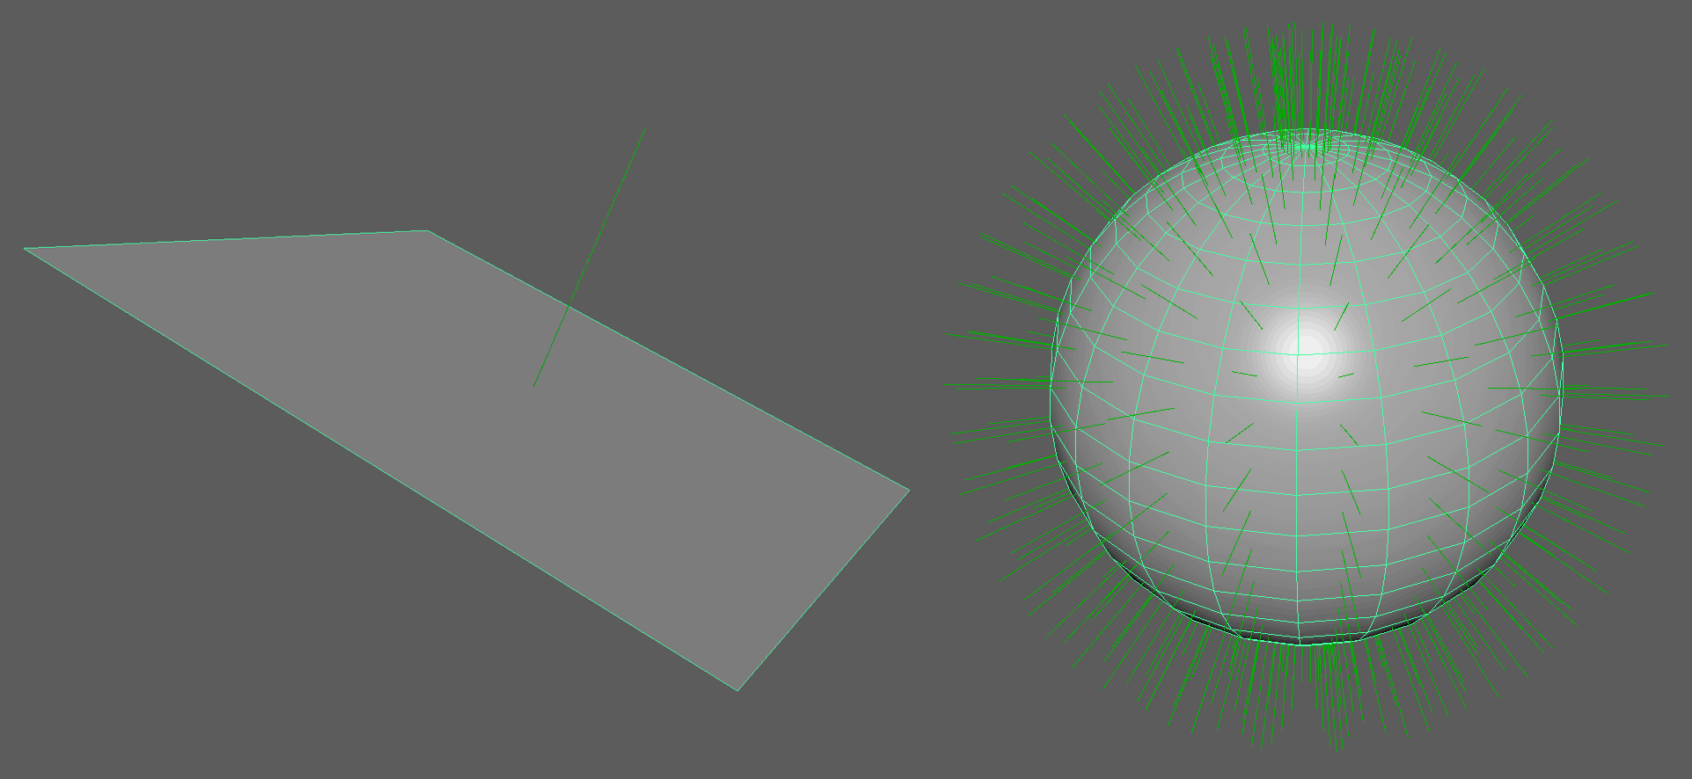
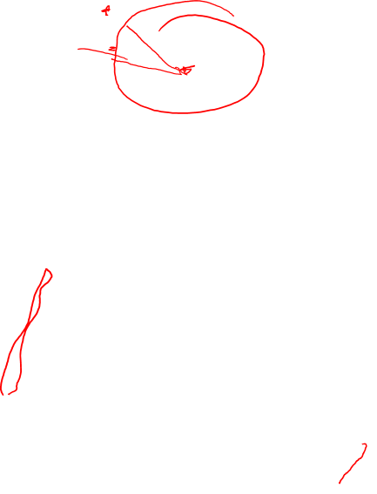
The principle
A surface has a normal, perpendicular to the plane of the surface.
Our light will hit this surface and use the normal to calculate diffuse and specular light.

Slide 10




Slide 11
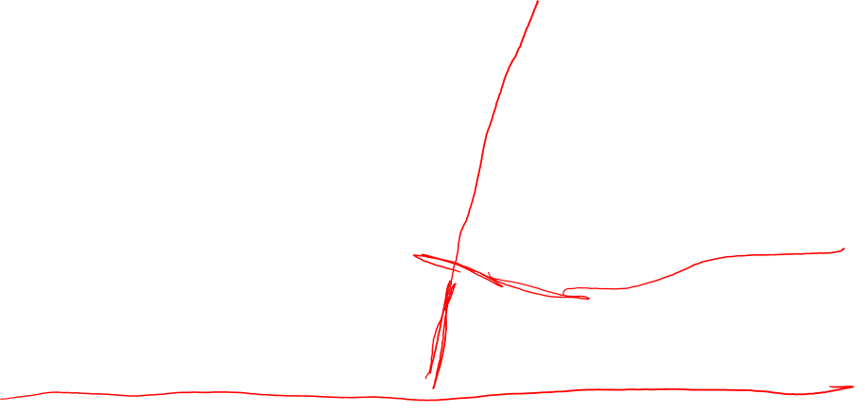

Slide 12
Why dose this happen?
Normals are just vectors
Normal maps are RGB
which is close enough to a vector, that we can encode a simple vector in each texel.
By multiplying the normal of our fragment to the normal of our normal map we can shift it so that the reflected light bounces off in a slightly different direction.

Slide 13
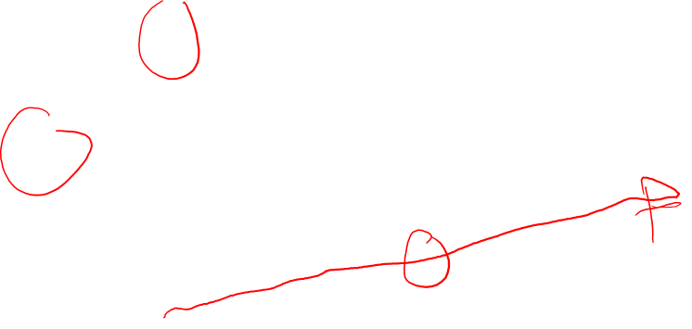
Tangent Space
In order to achieve this, we need to shift our normal map values in to Tangent space.
Tangents and bitangents are the 2 axis that are perpendicular to the normal axis (and each other) of a given vertex

Slide 14
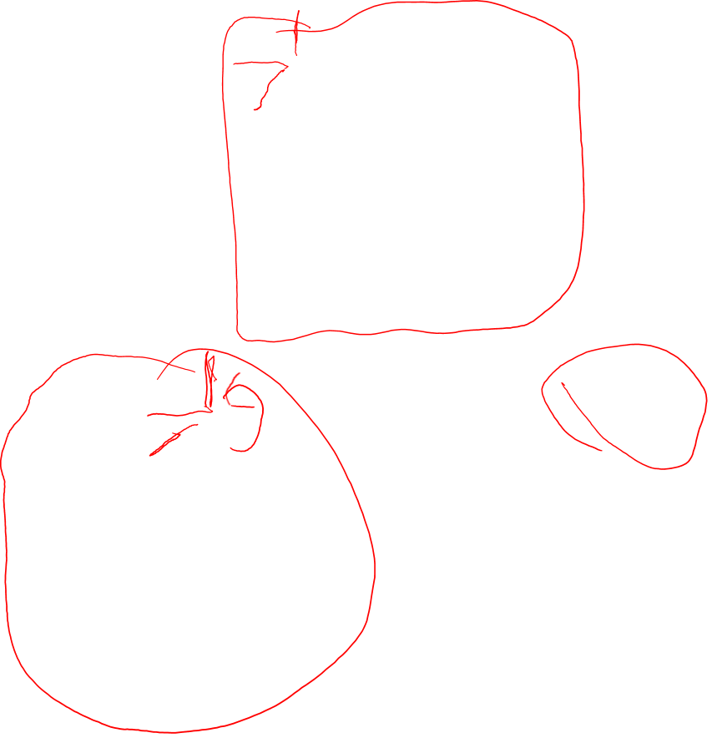
Mapping UVW to Tangent space
If we simply map our normal on to our tangents, our TBN directions would scale accordingly, in world space.
This is fine if we DO NOT ROTATE our models. But that’s no good for us as we are making games!
Things are supposed to move and rotate.
This is because, normal map values are defined in world space.
UVW = world XYZ
So we need to shift them in to model space.

Slide 15
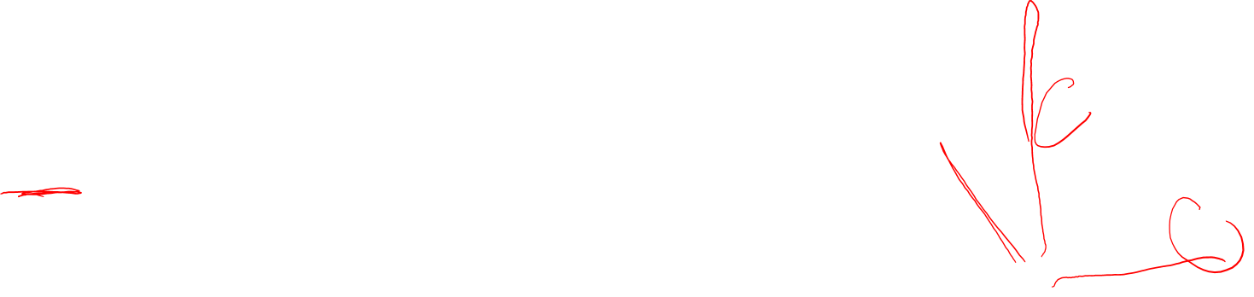
TBN
The Tangent, Bitangent, Normal matrix, represents the local axis and orientations of each vertex of a plane.
Calculating it is quite involved so I’m not going to do that here.
N vectors are saved in the mesh data.
We can calculate them, if we need to and we’ll be doing that in the tutorial.

Slide 16
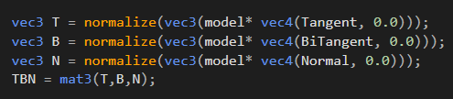

TBN to model space
Once you have the T, B and N, you just need to multiply them by the model transform (model in our shader code) and collect them in to a matrix 3

Slide 17
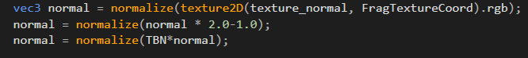
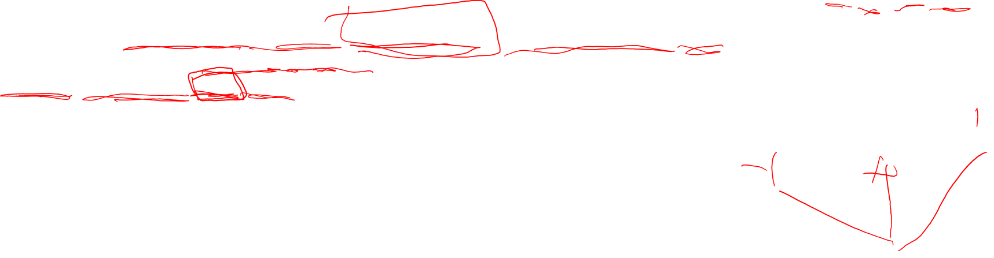
Applying the TBN to the Normal
Normal * 2 -1, converts the normal in the texture from 0 - 1 to -1 - 1

Slide 18
A different way

Slide 19
Per light normal mapping
So far we have talked about per fragment normal mapping
That is, the fragment shader is applying the normal shift to each fragment, so that its normals up in world space with the camera and light
We can flip this around in the vertex shader
Rather than altering the fragment normal, to world space, we can later the light and camera view to model space, using the transpose of the invers of the model, multiplied with T, B and N.
We then use TBN shit the light and camera position in to model space.
We calculate the fragment position as model * vert position.
We pass these new values to the fragment shader
We don’t need to alter the fragment shader from the light code we wrote last week

Slide 20
Why don’t we do it this way?
In my opinion its easier to understand shifting the normals into World space.
Method 2 is faster was we calculate the matrix shifts, per light, per vertex, rather than per fragment.
This method is faster for a few lights but its not as fast for lost of lights on small object
The less fragments, the better.

Slide 21
Questions?

Slide 22
Get On with it!

